Slide 1

Express & MongoDB Workshop

Slide 2



Who am I?
AITEUR Abdelatif
4th year CS Student at ESI-Algiers
Dev Departement Member at GDG Algiers
Abdelatif AITEUR
A_A#3350

Slide 3

Plan
Session 01:
Routing
Middlewares
SSR in ExpressJS
Session 02:
Cookies & Sessions
Session 03:
REST APIs
Session 04:
JWT auth

Slide 4
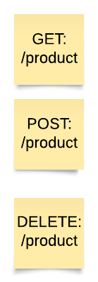

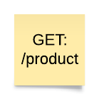

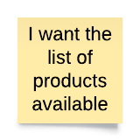
Routes
A route or routing refers to the process of defining endpoints or URLs that correspond to specific actions in your application
my.server.net/product
GET
DATA

Slide 5
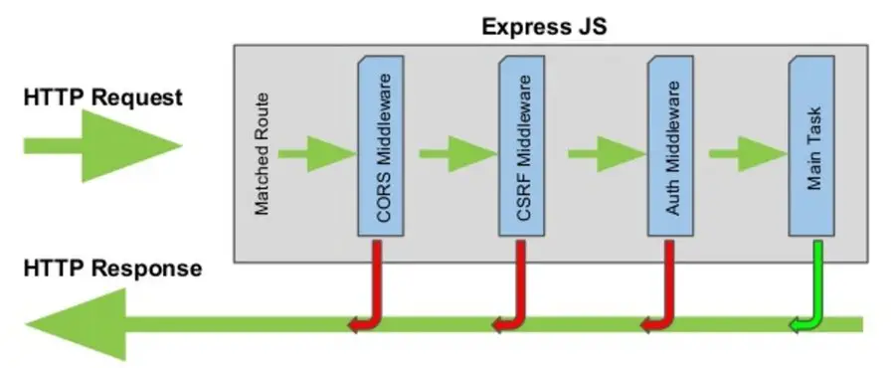
middlewares
Middleware is a function that can be called before executing the route handler.

Slide 6
middlewares
There are two types of middlewares:
Application-level middleware: is used to perform actions that are common to all routes or specific subsets of routes.
Route-level middleware:: is used to perform actions that are specific to a particular route.

Slide 7
middlewares
Here’s some well known middlewares:
Cors: enable cross-origin resource sharing in your app
Morgan: log HTTP requests and responses
Body-Parser: parse the request body
Cookie-parser: parse cookies in incoming requests
Express-session: manage user sessions
Express-rate-limit: limit the rate of incoming requests

Slide 8
SSR in ExpressJS
SSR (Server Side Rendring) means rendering a web page on the server and sending the fully rendered HTML to the client.
A view engine is a software component that enables the server to render dynamic views that are sent to the client.
View engines typically use a template system that allows developers to create a template that defines the layout and structure of the view, and placeholders that will be replaced with dynamic content at runtime.

Slide 9
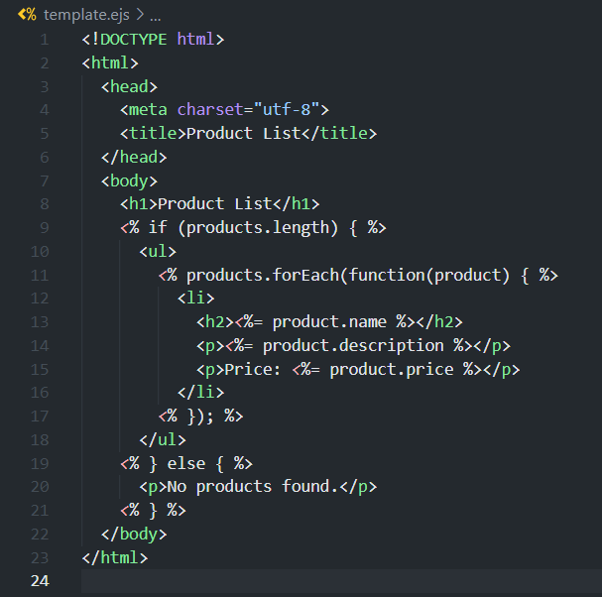
EJS
EJS (Embedded JavaScript) is a popular template engine for Node.js and browser-based JavaScript applications.

Slide 10
Let’s set up our project

Slide 11
Thank for your attention
Any questions?

